Slide 1


WELCOME TO PRESENTATION
My name is Kunal Chauhan, a pern developer
and I will be presenting this presentation to everyone present here.

Slide 2

Breast Cancer Classification using Machine learning
Project Presentation
Presented by: Kunal Chauhan BCA 4E
Supervisor: Mrs. Afsar Jahan
Graphic Era ( Deemed to be) University
Dehradun, Uttarakhand

Slide 3
TABLE OF CONTENTS
01
04
INTRODUCTION
MODEL TRAINING
02
05
WHY ML?
DATA COLLECTION
03
HOW TO USE ML / METHODOLIES?

Slide 4
TABLE OF CONTENTS
06
07
EVALUATION METRICS
RESULT

Slide 5


01
INTRODUCTION
What is Cancer?
Tumors are abnormal masses of tissue; types include benign (non-cancerous) and malignant (cancerous).
Causes: Genetic Mutations, Environmental Factors, Lifestyle Factors.
Types: Breast Cancer, Lung Cancer , Colorectal Cancer, Prostate Cancer etc.
Most Common Cancer in India is Breast Cancer.

Slide 6

Cancer Capital of Earth
India
Estimated cancer cases in India was
1.5 million in 2023
Out of which , approx. 300k cases were of
invasive breast cancer
Prevalence rate of 25.8 cases
per 100 people

Slide 7

WHY ML?
02
1. Precision in Analysis: Machine learning models can analyze imaging data with high precision, reducing errors in diagnosis.
2. Timely Identification: ML algorithms can detect subtle signs of cancer early, leading to prompt treatment and better outcomes.
3. Personalized Medicine: By analyzing genetic and clinical data, ML can help develop personalized treatment plans for each patient.
4. Large-Scale Analysis: ML can process and analyze vast amounts of data quickly, enabling the identification of patterns and insights that
may be missed by human analysis.

Slide 8

HOW TO USE ML
03
Get Started with Python
Understand Basic Algorithms of
Machine learning for Classification
3) Choose a methodology

Slide 9
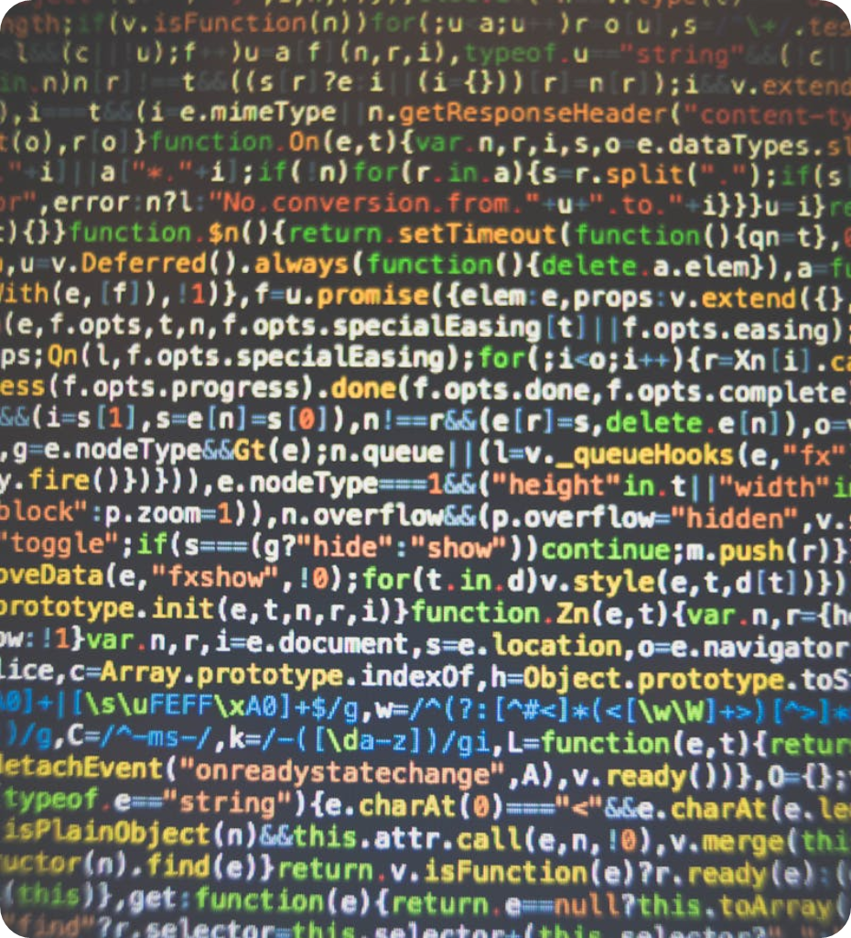
WHY PYTHON?
Simplicity and readability: Python's clean syntax makes writing and understanding complex algorithms easier.
Rich machine learning libraries: NumPy, Pandas, Scikit-learn, TensorFlow, and PyTorch provide powerful tools for data manipulation, analysis, and model development.
Flexibility and integration: Python's multi-paradigm nature and ability to integrate with C/C++ offer both versatility and performance optimization.

Slide 10
ALGORITHMS IN ML
Logistics Regression
Decision Trees
Neural Networks

Slide 11

METHODOLOGY
Data Collection: Medical imaging, genetic info, clinical records.
Preprocessing: Cleaning, feature selection, normalization, encoding, splitting datasets.
Model Development: Logistic Regression, training and testing.
Predictive System: Using the model for predictions.

Slide 12


04
DATA COLLECTION
Data Sources: Medical imaging data, genetic information, clinical records. In this mini project, we have taken data from scikilearn lib.
Preprocessing Steps:
Cleaning: Handling missing values and noise.
Feature Selection: Identifying relevant features for model training.
Encoding: Converting categorical data into numerical format.
Splitting: Dividing data into training and testing sets.

Slide 13


05
MODEL TRAINING
Model Used: Logistic Regression Training:
Split data into training (80%) and testing (20%) sets.
Data split into training data and test data
Train the logistic regression model on the training data.
Later, The model is evaluated on test data.

Slide 14


06
EVALUATION METRICS
Metrics Used: Accuracy, Precision, Recall, F1-Score.
Accuracy: Percentage of correctly classified instances.
Precision: Proportion of positive identifications that were actually correct.
Recall: Proportion of actual positives that were identified correctly.
F1-Score: Harmonic mean of precision and recall.

Slide 15


ACCURACY & RESULT
07
RESULT
Accuracy on training data = 0.9472527472527472
Accuracy on test data = 0.9298245614035088
Mini projects tells whether a tumor is benign[1] or malignant[0]

Slide 16

THANK YOU!
With regards,
Kunal Chauhan
BCA 4E (67)

